Slide 1


Sentiment Analysis for Travel Reviews
Sentiment analysis is a crucial tool for understanding the customer experience in the travel industry. By analyzing the sentiment expressed in travel reviews, businesses can gain valuable insights into the strengths and weaknesses of their services, identify areas for improvement, and enhance the overall customer satisfaction. This article will explore the various techniques and approaches used for sentiment analysis of travel reviews, from rule-based methods to advanced machine learning models.
Sa
by Saswat Swain

Slide 2
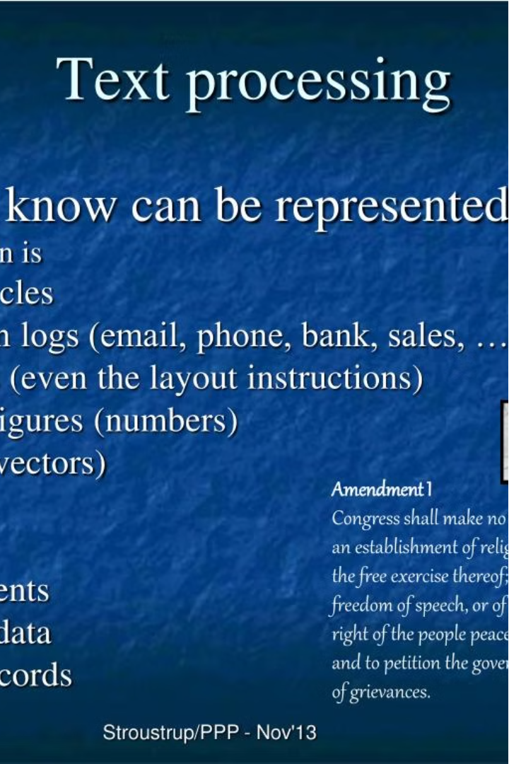
Tokenization and Sentence Splitting
The first step in sentiment analysis is to break down the text into its fundamental units, known as tokens, and then group these tokens into sentences. This process, called tokenization and sentence splitting, is typically performed using natural language processing (NLP) libraries like NLTK (Natural Language Toolkit) or spaCy. These libraries provide robust algorithms to accurately identify word boundaries and sentence boundaries, ensuring that the subsequent analyses are based on well-structured and meaningful units of text.

Slide 3
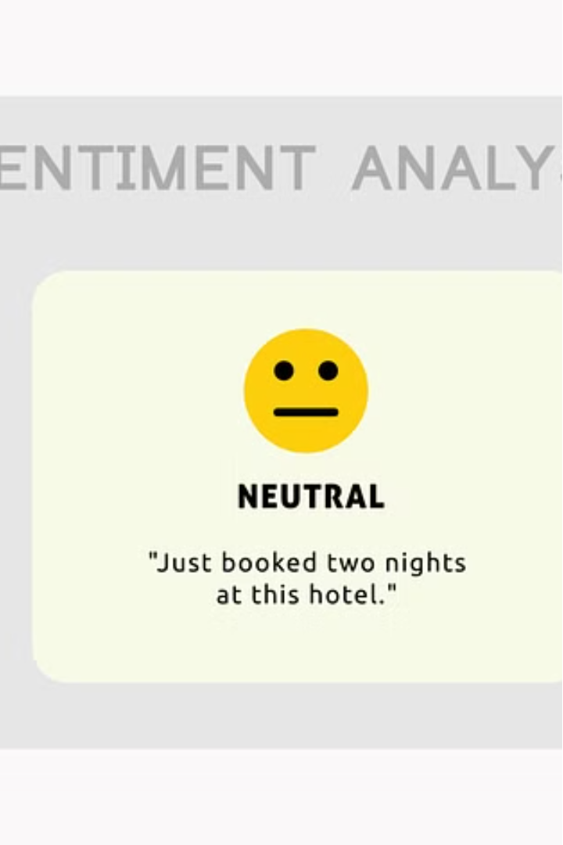
Keyword Matching and Sentiment Scoring
Once the text has been tokenized and split into sentences, the next step is to identify positive and negative keywords relevant to travel experiences. These keywords can be used to assign sentiment scores to each sentence based on their presence or absence. Positive keywords, such as "amazing," "wonderful," or "fantastic," will increase the sentiment score, while negative keywords, such as "terrible," "disappointing," or "dreadful," will decrease the sentiment score. This approach, known as keyword matching, is a rule-based method that can provide a quick and simple way to gauge the overall sentiment expressed in the reviews.

Slide 4
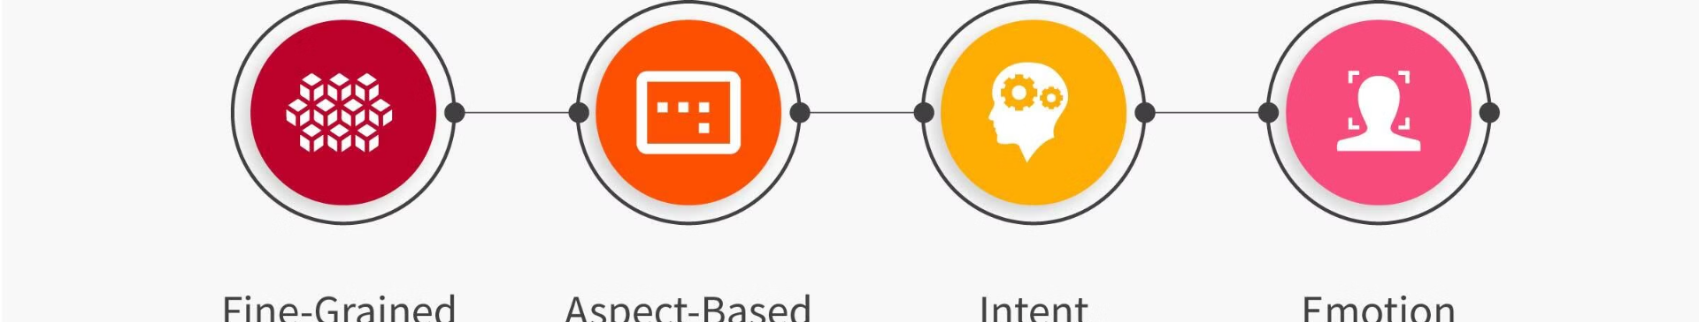
Tokenization and Sentiment Analysis Models
In addition to keyword matching, sentiment analysis can also be performed using more sophisticated techniques, such as tokenization and the application of pre-trained sentiment analysis models. These models, like VADER, TextBlob, or Hugging Face Transformers, are designed to analyze the polarity (positive, negative, or neutral) and intensity of sentiment expressed in each sentence. By tokenizing the sentences and feeding them into these models, businesses can obtain a more nuanced and accurate understanding of the sentiment conveyed in the travel reviews.

Slide 5
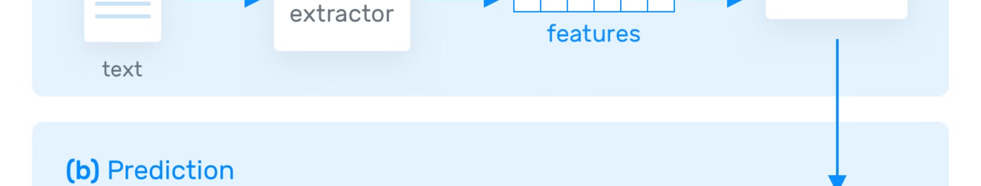
Rule-Based Sentiment Analysis
Another approach to sentiment analysis is the rule-based method, where specific rules or patterns are defined to capture common sentiment expressions in travel reviews. These rules can be designed to identify sentiment polarity based on sentence structure, specific phrases, or combinations of words. For example, a rule might be: "If a sentence contains the word 'disappointed' and the word 'hotel,' then the sentiment is negative." This approach can be particularly effective when dealing with domain-specific language or idiomatic expressions that may not be well-captured by pre-trained sentiment analysis models.

Slide 6
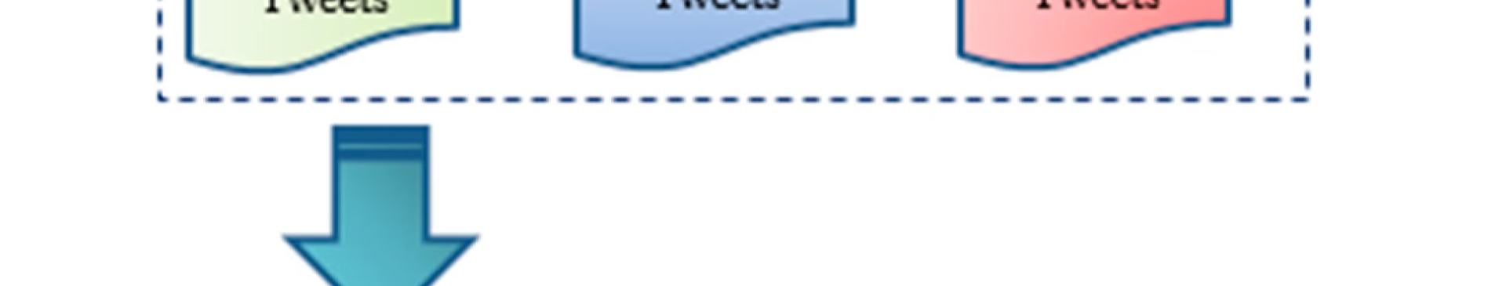
Machine Learning for Sentiment Analysis
In addition to rule-based methods, sentiment analysis can also be performed using supervised machine learning models. These models are trained on labeled data, where each sentence is assigned a sentiment score, and then used to predict the sentiment of new, unseen reviews. Common machine learning models used for sentiment analysis include Support Vector Machines (SVMs), Logistic Regression, Naive Bayes, Recurrent Neural Networks (RNNs), and Transformer-based models like BERT. These models can leverage a variety of features, such as word embeddings, n-grams, syntactic features, or sentiment lexicons, to accurately predict the sentiment expressed in the reviews.

Slide 7
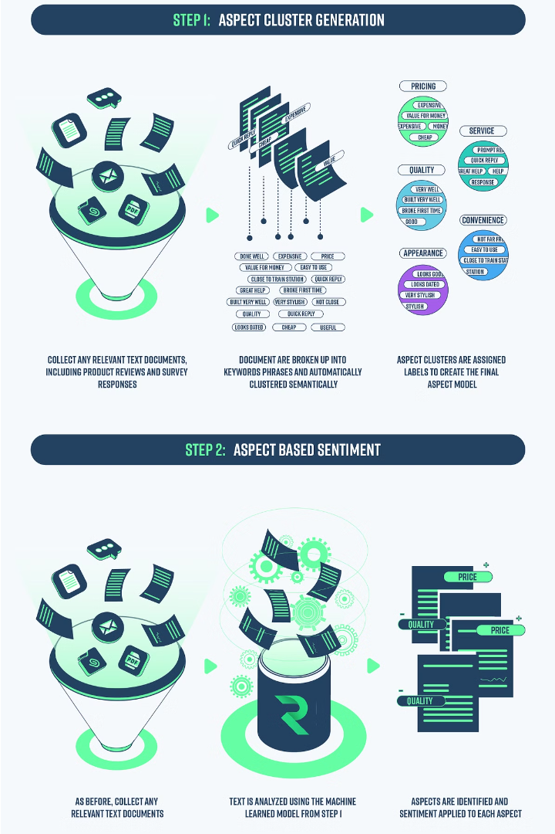
Aspect-Based Sentiment Analysis
Sentiment analysis can also be performed at a more granular level by focusing on specific aspects or features mentioned in the reviews, such as punctuality, comfort, or food quality. This approach, known as aspect-based sentiment analysis, involves identifying the relevant aspects within each sentence and then analyzing the sentiment expressed towards those aspects. This can provide businesses with a more detailed understanding of the customer experience, allowing them to identify specific areas for improvement.

Slide 8
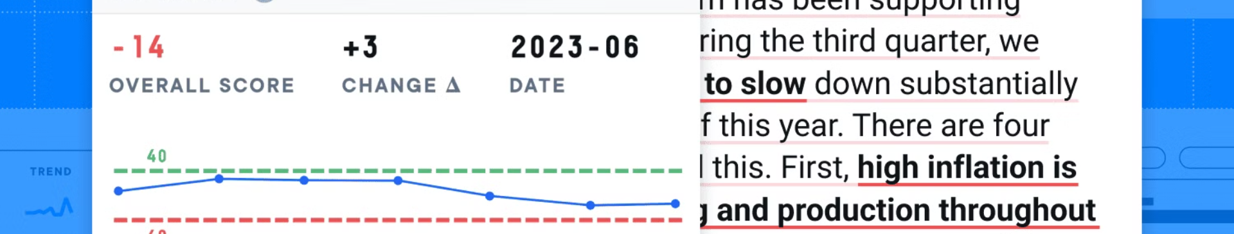
Sentiment Score Aggregation and Normalization
After computing the sentiment scores for individual sentences, the next step is to aggregate these scores to derive an overall sentiment score for each review. This can be done through simple averaging or weighted averaging, where the weight of each sentence's sentiment score is determined by its importance or relevance. Additionally, it is important to normalize the sentiment scores to a standardized scale (e.g., -5 to 5) to ensure consistency across different reviews and enable meaningful comparisons.

Slide 9
Advanced Sentiment Analysis Techniques
To further enhance the accuracy and robustness of sentiment analysis, there are several advanced techniques that can be employed. These include the use of custom sentiment lexicons tailored to the travel domain, handling of negation and intensifiers, and contextual analysis to understand how the sentiment of one sentence may affect the sentiment of subsequent sentences. By leveraging these techniques, businesses can gain a deeper and more nuanced understanding of the sentiment expressed in travel reviews, ultimately leading to better-informed decisions and improved customer experiences.

